Slide 1
UNIQ+ R COURSE
Monday 15th July
Oxford 2024

Slide 2
MORNING
Conditionals
Loops
Exercise and discussion
Functions
AFTERNOON
Reproducible data analysis (commenting, Rmarkdown)
Intro to datasets for projects

Slide 3
CONDITIONALS
Thursday 8th July

Slide 4
Conditionals:
Useful when you do not want to execute one statement after another but to have control over the flow of execution also.
Determine if a specified condition is met (or not) then direct subsequent analysis or action depending on the result
There are basic conditionals and syntax in R
if → if (condition) statement
If…else → if (condition) statement 1 else statement 2
ifelse → ifelse (condition, yes, no)

Slide 5
Conditionals: if statements
If produces a logical value from the condition and carries out the next statement only when the value becomes TRUE.
If statements are a Boolean expression followed by a single or multiple statements.
Condition: any expression that evaluates TRUE or FALSE.
if (condition) {
do something
}
x = 6
if (x > 4) {
print(“Number higher than 4”)
}
?
x > 4
condition
TRUE
print(“Number higher than 4”)
statement
Number higher than 4

Slide 6
Conditionals: if…else statements
If statements are followed by an optional ”else” statement that gets executed when the Boolean expression becomes false.
if (condition) {
do something if condition is true, this happens (TRUE branch)
} else {
do something else if condition is false, this happens (FALSE branch)
}
x = 6
if (x > 8) {
print(“Number higher than 8”)
}else{
print(“Number lower than 8”)
}
?
x > 8
condition
FALSE
TRUE
print(“Number lower than 8”)
print(“Number higher than 8”)
statement B
statement A
else block (FALSE BRANCH)
If block (TRUE BRANCH)

Slide 7
Conditionals: chained conditionals (else if)
if (condition A is TRUE) {
do something (statement A)
} else if (condition B is TRUE) {
do something else (statement B)
} else {
do something else (statement C)
}
x = 0
if (x > 0) {
print(“Positive number”)
}else if (x < 0){
print(“Negative number”)
} else {
print(“Zero”)
}
If first condition is true, statement A is executed
New condition to test if previous one was false
False branch.
Executed if none of the conditions above are true

Slide 8
Conditionals: chained conditionals (else if)
if (condition A is TRUE) {
do something (statement A)
} else if (condition B is TRUE) {
do something else (statement B)
} else {
do something else (statement C)
}
x = 0
if (x > 0) {
print(“Positive number”)
}else if (x < 0){
print(“Negative number”)
} else {
print(“Zero”)
}
Condition A
TRUE
statement A
FALSE
Condition B
TRUE
statement B
FALSE
statement C

Slide 9
Conditionals: ifelse() function
Conditional statements are not vector operations, they deal only with a single value.
If we pass the if statement to a vector it will generate a warning.
ifelse() function checks the condition for every element of a vector and selects elements from the specified vector depending upon the result
Syntax:
ifelse(condition, TrueBranch, FalseBranch)

Slide 10

Let´s practice!
Image by lucabravo on Freepik

Slide 11
LOOPS
Monday 15th July

Slide 12
Loops
Programming instruction that repeats a chunk of code until a specific condition is reached. The loop executes a code block again and again until no further action is required.
Iteration: repetition of a process. Each time the code block within the code is executed is called iteration.
Loops are great tools to play around with code and gain a deeper understanding of R.
We will see for loops and while loops

Slide 13
Loops: for-loops
Used to iterate over a sequence.
Perform same action for each item in a list of things.
Syntax:
for (val in sequence)
{
statement
}
Where the sequence can be a vector or a list and val takes a different value each time during the loop. The same statement is evaluated in every iteration.

Slide 14
Loops: for-loops
genes = c(“PI3K”, “FOXO”, “VLDL”, ”LIPC”)
for (val in genes)
{
print(val)
}
[1] "PI3K”
[1] "FOXO"
[1] "VLDL"
[1] "LIPC"

Slide 15
Loops: while-loops
Used to iterate indefinitely as long as certain logical condition is TRUE.
It is called condition-controlled loop.
Syntax:
while (condition)
{
statement
}
Loop body. Executed as long as condition is TRUE

Slide 16

Loops: while-loops
x = 0
while (x < 10)
{
x = x + 1
print (x)
}
[1] 1
[1] 2
[1] 3
[1] 4
[1] 5
[1] 6
[1] 7
[1] 8
[1] 9
[1] 10
condition
FALSE
TRUE
statement
Exit loop

Slide 17
Let´s practice!
Let´s practice!
Image by lucabravo on Freepik

Slide 18
FUNCTIONS
Friday 8th July

Slide 19
Functions
Set of statements organized together to perform a specific task.
R has a large number of in-built functions. Everything is a function really!
Syntax:
function.name = function (arg1, arg2, …)
{
function body
}

Slide 20
Loop functions
apply(), lapply(), mapply() can be used instead of the for loop – effectively the same result, but syntactically easier sometimes

Slide 21
Let´s practice!
Let´s practice!
Image by lucabravo on Freepik

Slide 22
UNIQ+ R COURSE
Monday 15th July
Oxford 2024

Slide 23
R markdown
Monday 15th July
Oxford 2024

Slide 24
R markdown
Easy way to combine:
Plain text
Code
Data analysis (plots & tables)
Hyperlinks
…into a single nicely formatted and reproducible document

Slide 25
R markdown
Why?
Transparency
Reproducibility (links your data with your R code)
You can create a variety of output formats
Increases efficiency if something needs to be changed

Slide 26
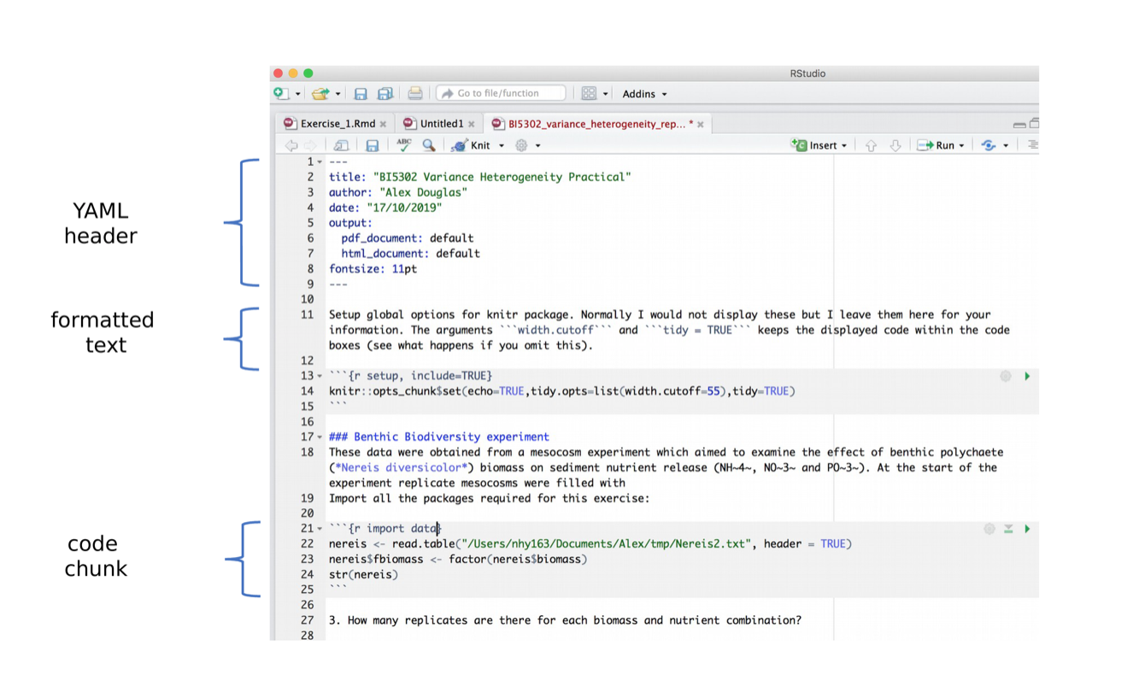
R markdown
https://intro2r.com/r-markdown-anatomy.html

Slide 27
R markdown
https://www.rstudio.com/wp-content/uploads/2015/02/rmarkdown-cheatsheet.pdf
https://intro2r.com/r-markdown-anatomy.html

Slide 28
Intro to datasets
Monday 15th July
Oxford 2024

Slide 29
Datasets for project
Best songs on Spotify (headstart)
Student mental health (headstart)
Diabetes (headstart)
US births
Glass Door Gender Pay
WHO Life Expectancy
UFO sightings (Excel file – either save as .csv in Excel an then load into R, or load the Excel file directly into R using the readxl package)
Bladder cancer (3 files)
Fitbit (2 files)

